Slide 1
Natural Language Processing
With Python!
Hacknight #?

Slide 2
What we’re Covering…
01
02
03
Natural Language Processing?
Introduction to NLTK
How to use and examples!

Slide 3
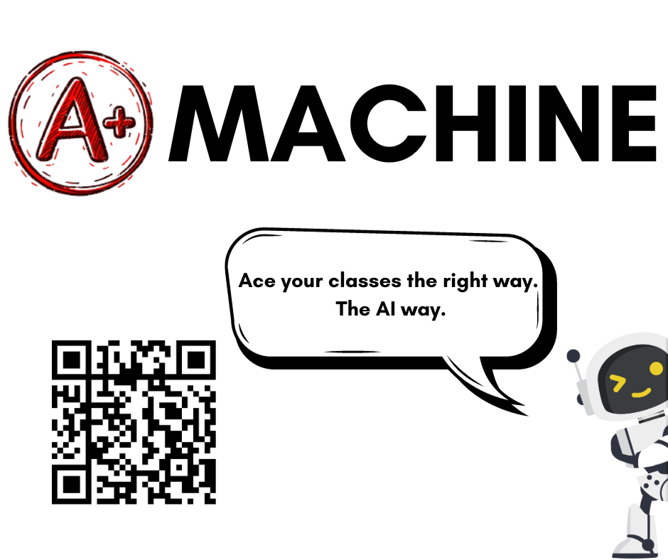

Slide 4
01
Natural Language Processing

Slide 5

NLP - Natural Language Processing
NLP - Gives computers the ability to support and manipulate human language
Processing Natural Language
Understanding context of text.
Extracting information and insights.
Determining the theme or tone of a text.
Creating human-like text / speech.
Notes:
d3’s slide

Slide 6
Applications of NLP
Text & Speech Processing
AI Power!
Using NLP for OCR, customer service chatbots, robocalls, text-to-speech, etc.
Semantic Analysis
Using AI with NLP for grammatical error correction, translation, natural-language generation / understanding, and more!
Extracting information from text like context, emotions, sentiment, topics, definitions, and much more!

Slide 7
Why NLP is important
Communication
Big Data Analysis
Enhancing computer understanding and search engines and virtual assistants to language translation services.
NLP analyze vast amounts of unstructured data, extracting valuable insights from texts, emails, social media, and other sources.
AI
Inclusivity
Chatbots duh
NLP makes up the basis for translation software, allowing technology to be more accessible to others.

Slide 8
02
Intro to NLTK

Slide 9

What is NLTK?
NLTK - Natural Language ToolKit
Python library for natural language processing.
There are four concepts in NLTK that you’ll need to know to get started:
Tokenizing
World Filtering
Part of Speech Tagging
Chunking & Trees

Slide 10
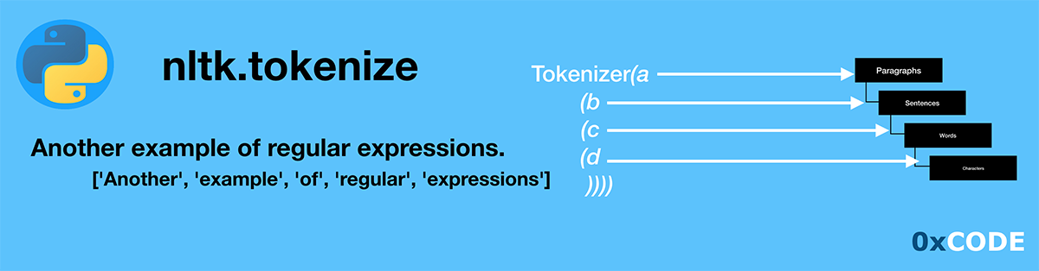
Tokenizing
Tokenizing is crucial for working with language for processing
Tokenizing is the process of separating text either by word or by sentence
Tokenizing by word turns a sentence into an array of words (you can figure out what happens when you tokenize by sentence)

Slide 11

Word Filtering
Filtering is an important step in processing language
When processing language, filler words must be removed as they serve no purpose
NLTK does this with stop words. Stop words are common words like ‘in’, ‘is’ and ‘an’
Filtering is the process of removing these words from a sentence

Slide 12
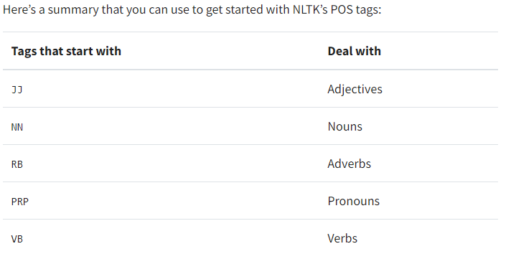
Part of Speech Tagging
Tagging in NLTK is how we work with words and define grammar
Tagging is the process of defining individual words by their part of speech or other criteria
There are ~40 different tags for every word in the English language
These tags are used in grammar to further process text.

Slide 13
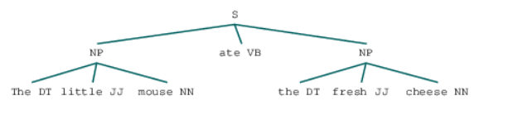
Chunking & Trees
Chunking allows for identification of grammar within NLTK
This grammar is defined by regular expressions (regexes)
These can be incredibly useful for finding specific information in a large body of text

Slide 14
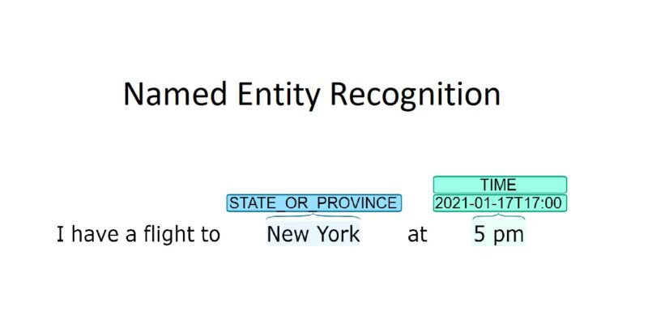
Named Entity Recognition
Named Entity Recognition (NER) focuses on identifying and classifying named entities within text. Named entities are real-world object such as:
Persons
Organizations
Locations
Dates
Numerical values
NER aims to extract and categorize these entities to provide a deeper understanding of the content and relationships within a text.

Slide 15
03
Using NLTK with Python & Examples!

Slide 16
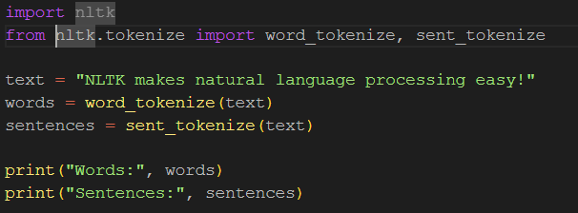
Tokenizing

Slide 17
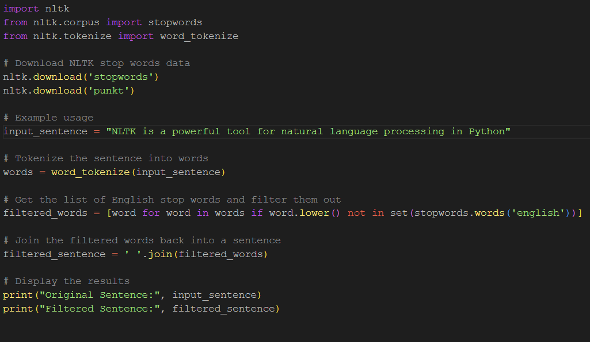
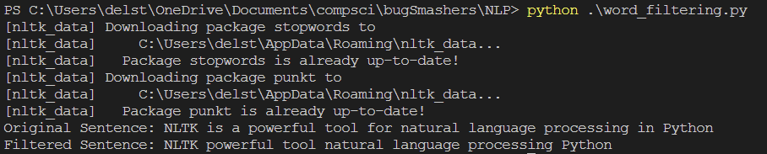
Word Filtering

Slide 18
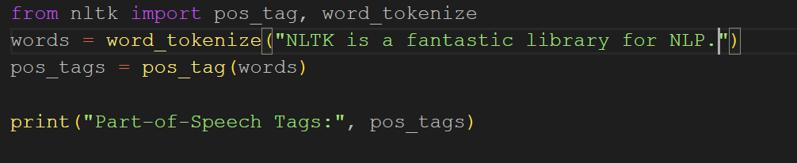
Part of Speech Tagging

Slide 19
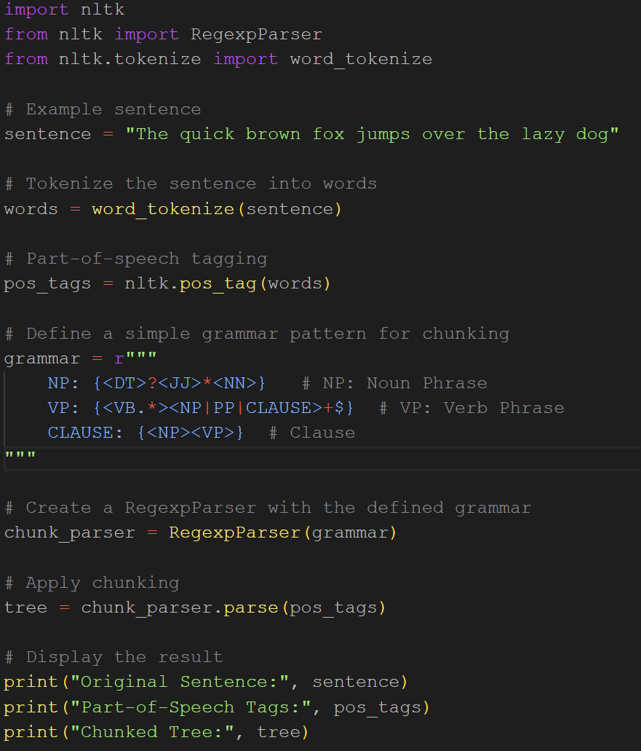
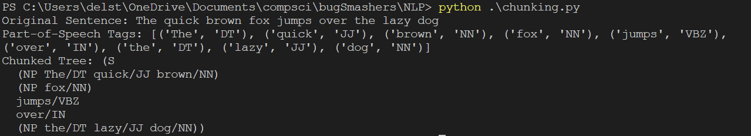
Chunking & Trees

Slide 20
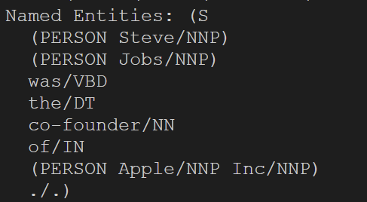
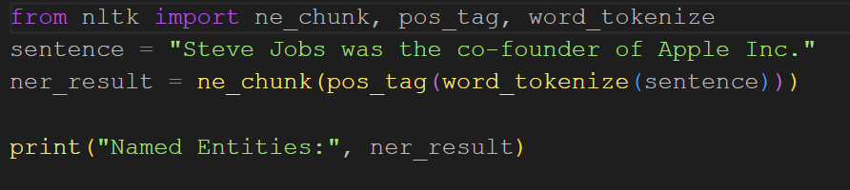
Named Entity Recognition

